Slide 1
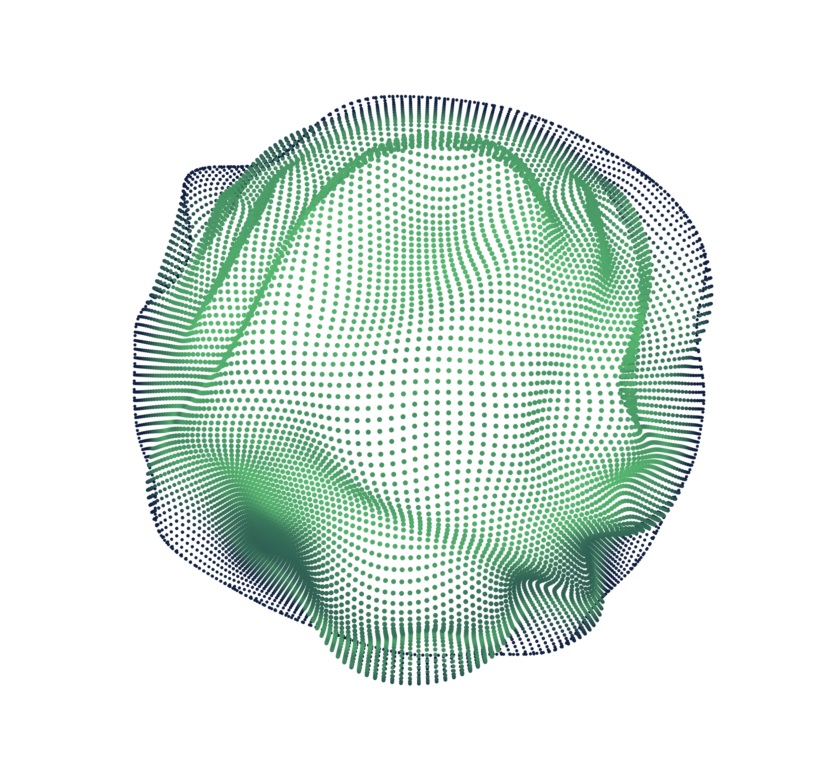


Mini Research Project
Title: Emotion Recognition From Human Speeches: Introducing the Three-Stage Pipeline
Submitted By:
20301305 MD Rishat Sheakh
20301326 Sartaj Emon Prattoy
20301367 Awon Bin Kamrul
CSE424 Section -1, Group 26

Slide 2

Table of Content
Introduction ------------------------------------------------------------------------------------------------- 3
Literature Review ------------------------------------------------------------------------------------------- 4
Dataset Analysis -------------------------------------------------------------------------------------------- 6
Methodology ------------------------------------------------------------------------------------------------ 9
Schematic Representation ------------------------------------------------------------------------ 10
Data preparation ------------------------------------------------------------------------------------ 11
Data augmentation---------------------------------------------------------------------------------- 12
Feature extraction----------------------------------------------------------------------------------- 12
Transfer Learning models--------------------------------------------------------------------------------- 13
GoogleNet------------------------------------------------------------------------------------------- 13
Inception_V3----------------------------------------------------------------------------------------- 14
ResNet------------------------------------------------------------------------------------------------ 15
Results and Discussion------------------------------------------------------------------------------------- 16
Future Work-------------------------------------------------------------------------------------------------- 18
Conclusion --------------------------------------------------------------------------------------------------- 19

Slide 3
Introduction
Today, we'll dive into the intriguing world of understanding emotions conveyed through human speech. We'll unveil a sophisticated three-stage pipeline that revolutionizes how we interpret and analyze vocal expressions.
Exploring the fascinating realm of emotion recognition through human speech, unveiling a sophisticated three-stage pipeline.
In our digitized world, understanding emotions through speech holds profound significance for communication technology and human psychology.
Our research revolutionizes how we decipher vocal expressions, paving the way for advancements in human-computer interaction and mental health assessment.

Slide 4
Paper Review for: Automatic Speech Emotion Recognition Using Support Vector Machine
Speech Emotion Recognition (SER) vital in Human-Computer Interaction. Research involves database analysis, feature extraction, and classification methods.
Methodology Utilizing Berlin Emotional Speech Database for analysis. Features include energy, pitch, LPCC, MFCC, LPCMCC; SVM-based classification.
Outcome Combining features boosts recognition accuracy. Best accuracy achieved with energy, pitch, LPCMCC (82.5%). Future focus on improved features and real-time applicability.
Paper review for: Multimodal Emotion Recognition Study by Luna-Jiménez et al.(2021)
In this paper the effectiveness of multimodal emotion recognition systems by combining speech and facial information.
Methodologies included transfer learning techniques, fine-tuning CNN-14 for speech emotion recognition, STN for facial emotion recognition.
Achieves an 80.08% accuracy on the RAVDESS dataset
Limitation include potential challenges in generalizability, diverse demographic groups and other conditions highlights needs for further research.
https://doi.org/10.3390/s21227665

Slide 5
Paper review for: Multimodal SER Hierarchical Approach by Singh et al. (2021)
This paper introduces a hierarchical deep learning-based approach for speech emotion recognition (SER)
Framework incorporates 33 acoustic features for audio-based SER
Hierarchical deep neural networks (DNNs) were utilized to process and classify emotions
Shows Superiority of the hierarchical approach by outperforming recent techniques
Achieves SER accuracies of 81.2%, 81.7%, and 74.5% on SAVEE, RAVDESS, and IEMOCAP datasets
https://doi.org/10.1016/j.knosys.2021.107316
Paper review for: Human Speech Emotion Recognition Using SVM Abdul-hadi et al. (2020)
In this paper, with SVM integrating facial expressions and speech signals to enhance emotion recognition,
Methodology includes employed preprocessed video data, extracting features via Histogram of Oriented Gradients (HOG) from facial images and speech signals
Study Result The SVM model demonstrated 85.72% accuracy.
Future Work Future endeavors include exploring additional modalities, real-time implementation, addressing cultural differences, and extending applications beyond human-computer

Slide 6

Dataset Analysis
Crowd Sourced Emotional Multimodal Actors Dataset (CREMA-D)
Diverse Dataset:
7,442 original clips from 91 actors.
Varied demographics: 48 male, 43 female, spanning ages 20-74, multiple races/ethnicities.
Emotion Representation:
12 sentences expressing 6 emotions at 4 intensity levels.
Emotions: Anger, Disgust, Fear, Happy, Neutral, Sad.
Feature Extraction:
Extract acoustic, linguistic, and audiovisual features.
Capture relevant information for emotion recognition.
Visualization Tools:
Use Python libraries (e.g., Matplotlib, Seaborn) for data visualization
https://doi.org/10.1109/TAFFC.2014.2336244

Slide 7
Dataset Analysis
Ryerson Audio-Visual Database of Emotional Speech and Song (RAVDESS)
Multimodal Database:
Includes emotional speech and song
Stimuli.
Gender-balanced with 24 professional actors.
Emotional Intensity Levels:
Each expression produced at normal and strong intensity levels.
Additional neutral expression available.
Validation and Ratings:
7,356 recordings rated 10 times on emotional validity, intensity,genuineness.
Ratings provided by 247 individuals for reliability assessment.
https://doi.org/10.1371/journal.pone.0196391

Slide 8

Dataset Analysis
Surrey Audio-Visual Expressed Emotion (SAVEE)
Content:
Male-only, providing high-quality audio recordings.
Recorded from four native English male speakers aged 27 to 31.
Emotions:
Anger, disgust, fear, happiness, sadness, surprise, and neutral.
Performance Evaluation:
Classification systems developed for audio, visual, and audio-visual modalities.
Speaker-independent recognition rates achieved: Audio-visual: 84%
http://kahlan.eps.surrey.ac.uk/savee/Database.html

Slide 9
Methodology
Emotion detection process comprises a three-stage pipeline
Feature Extraction
Data augmentation for signal analysis.
Mel spectrogram extraction.
Pre-trained CNN Models
ResNet18, Inception_v3, GoogleNet.
Ensemble learning
Modified function.
Final prediction scores.

Slide 10
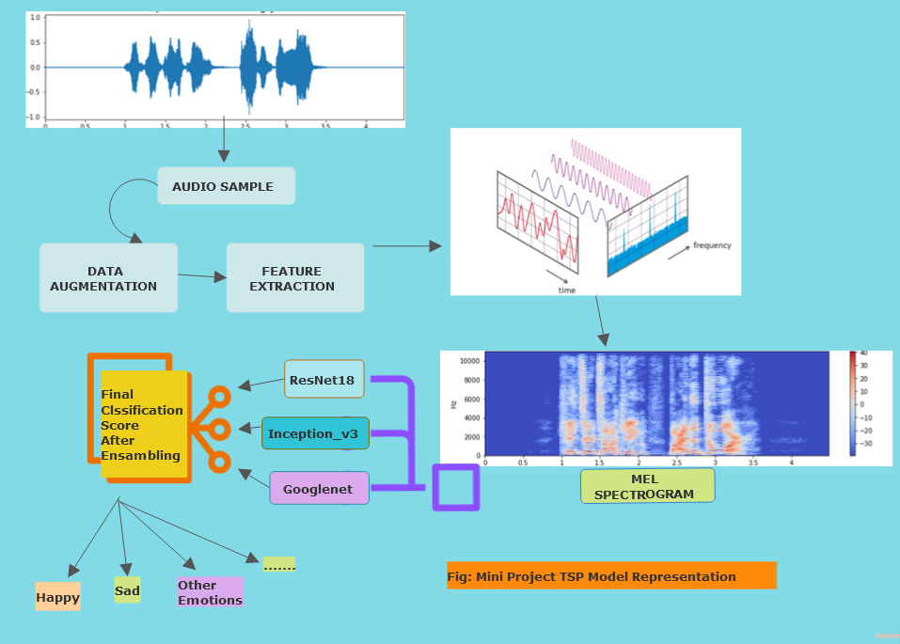
Schematic Representation
of Our TSP Model
Figure: Three Stage Pipeline model

Slide 11
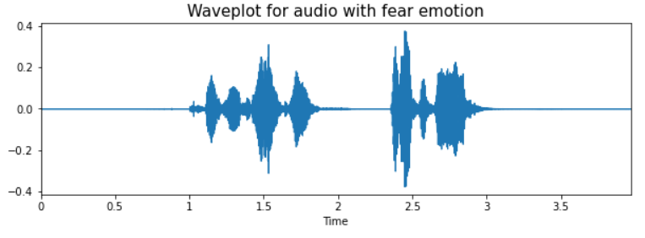
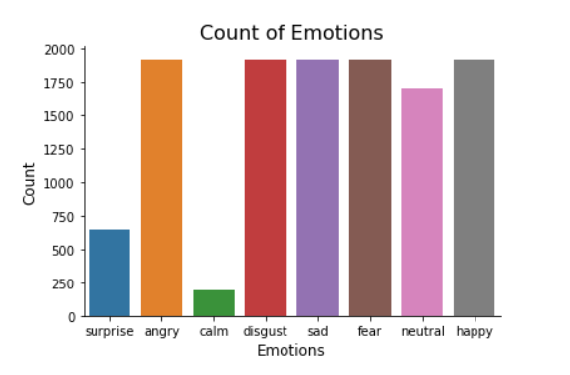
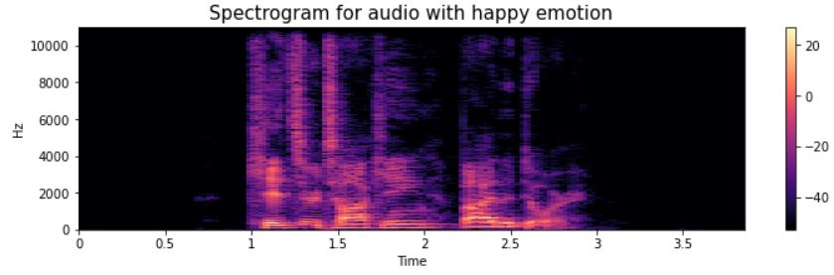
DATA PREPARATION
Three Different datasets used
Create data frame to store all the emotions of their data with their paths
Data frame is used in Feature extraction
Data visualization and Exploration
Wave plots
Each emotion count was plotted
Spectrographs for audio signals

Slide 12
DATA AUGMENTATION
FEATURE EXTRACTION
create new synthetic data samples by adding small perturbations to initial training set
Various Augmentation Methods
noise injection
shifting time
changing pitch
shifting time was used
Equation : Xnew = X [n ± s]
Model Can't understand the provided audio data
Feature extraction transforms data into model Understandable one
Various augmentation methods
Chroma Deviation
Spectral Centroid
Zero Crossing Rate
Mel Spectrogram
Our CNN based model is suitable with Mel Spectrogram method
Fourier Transforms on sound signals generates Spectrograms
we get a frequency versus time graph
Mel scale maps a tone's perceived frequency to its measured frequency

Slide 13
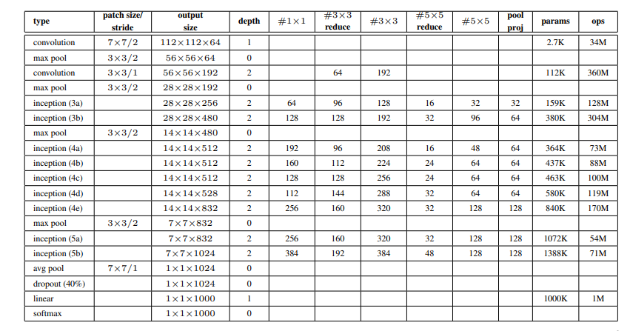
TRANSFER LEARNING
GoogleNet Architecture
GoogleNet Background:
Introduced in 2014 by Google researchers.
Departure from previous architectures like
AlexNet and ZF-Net.
Key Features:
Utilizes 1×1 convolutions and global average pooling.
Enables deeper architectures.
Global Average Pooling:
Reduces feature map size to 1×1, decreasing
parameters to 0.
Improves top-1 accuracy by 0.6%.
Inception Module:
Employs fixed convolution sizes.
Executes parallel operations for enhanced object detection.
Utilizes convolution filters of different sizes.

Slide 14
Inception_v3 Architecture
Inception_v3:
Widely employed 2D CNN model renowned for robust classification performance.
Developed as an extension of the GoogLeNet model.
Key Features:
Utilizes transfer learning for strong classification capabilities.
Extensively incorporates Batchnorm in activation layers.
Input Size and Convolution Layers:
Operates on input sizes of 299 × 299 × 3.
Employs multiple convolution layers for feature extraction.
Inception Blocks:
Enables diverse filter computation.
Concatenates filters into a single feature map, reducing computational complexity.
Minimizes parers for enhanced efficiency.

Slide 15
ResNet Architecture
Overview of ResNet:
Introduced in 2015 to address the "degradation problem" in deep networks.
Utilizes residual mapping to improve CNN model optimization.
Features:
ResNet-18 is pre-trained on the ImageNet dataset.
Accepts input images of size 3 × 224 × 224.
Performance and Variants:
Performance improves with increasing network depth.
Variants include ResNet-18, ResNet-34, ResNet-50, ResNet-101, and ResNet-110.
ResNet-18 in Application:
Balanced computational complexity and accuracy.
Utilized in our proposed three-stage-pipeline framework.

Slide 16
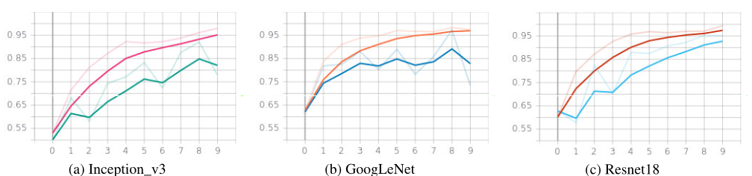
Results and Discussion
Outcomes of models on RAVDESS dataset:
Inception_V3 model achieved 92.07% accuracy
ResNet18 model achieved 95.29% accuracy
GoogLeNet model achieved 97.24% accuracy

Slide 17
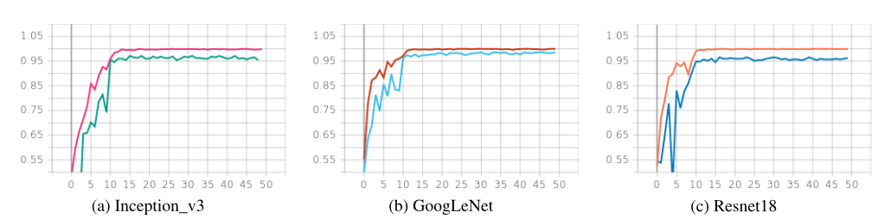
Results and Discussion
Outcomes of models on CREMA-D dataset:
Inception_V3 model achieved 98.76% accuracy
ResNet18 model achieved 98.77% accuracy
GoogLeNet model achieved 99.08% accuracy

Slide 18
Future Work
Binary Classification Techniques:
Implement binary classification techniques, including the One vs. All method
Enhance the model's class discrimination capabilities
Ensembling Phase Integration
Integrate the ensembling phase to optimize
Explore combining predictions from three pre-trained CNN transfer learning models to enhance overall model performance.
ROC Curve Analysis
Analyze ROC curves for the ensemble model on RAVDESS, CREMA-D, and SAVEE datasets
Gain insights into the model's ability to differentiate between classes

Slide 19
Conclusion
Approach to SER:
SER methodology using transfer learning with 2D CNN models
Utilization of pre-trained models on audio datasets
Future Directions:
Opportunities for further refinement exist
Exploration of alternative feature sets and data augmentation techniques.
Aims to enhance model generalization and performance in audio analysis tasks
Success of Three-Stage Pipeline:
Significant success in achieving accuracy across benchmark datasets.
Enhances model flexibility and efficiency

Slide 20


